Slide 1

IntelliBallot: A Innovative Fusion of Biometrics for Secure Voting
Team guide:
Mr. G.V. Ramana , M. Tech
Assistant professor
Department of ECE
Team Members:
P. H. C. Sai Santhosh (203B1A0438)
P. Satish Reddy (203B1A0435)
G. Manikanta Swamy (203B1A0413)
H. Santhosh Kumar (203B1A0416)
Ch. Gowtham (203B1A0457)

Slide 2
Abstract:
The project aims to revolutionize the electronic voting paradigm by combining the strengths of fingerprint technology and face recognition. The primary objective is to enhance the security, accuracy, and inclusivity of electronic voting systems by leveraging advanced biometric authentication methods. In the proposed system, voters' identities are verified through a seamless integration of fingerprint recognition and face recognition technologies. This hybrid approach by using Raspberry Pi. It not only strengthens the security measures but also ensures a more robust and reliable authentication process. The integration of both biometric modalities adds an extra layer of accuracy, making it significantly challenging for unauthorized access or fraudulent activities.
Keywords: Biometric Authentication, Electronic Voting System, Fingerprint Technology, Face Recognition, Security, Inclusivity, Raspberry Pi, Electoral Integrity.

Slide 3
Block Diagram:
Power Supply
Fingerprint Sensor
website
Web Camera
Raspberry Pi
Python programming
Messages & Output

Slide 4
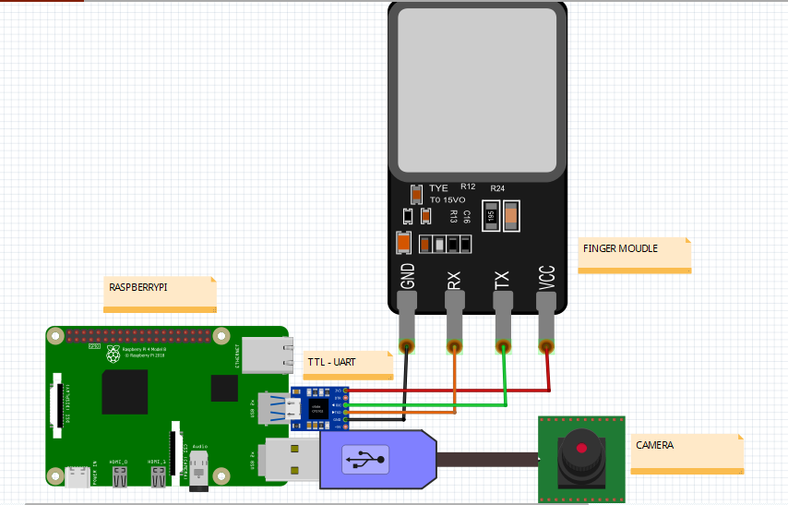
Circuit diagram:

Slide 5
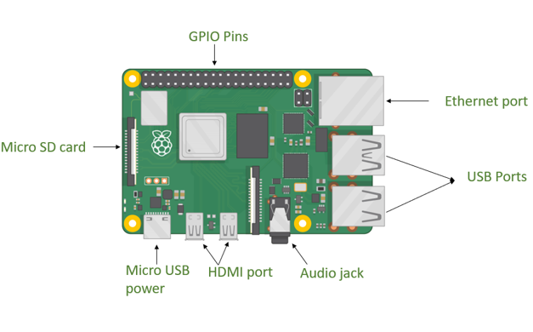
Explanation of Block Diagram:
Raspberry Pi:
1. Introduction :
- Single-board computer featuring diverse capabilities.
2. Key Hardware Specifications:
GPIO Pins: Equipped with 40 GPIO pins for extensive device connections.
- Analog Inputs: It supports analog-to-digital conversion.
- Memory: For example, Raspberry Pi with up to 4GB RAM.
3. Compatibility:
- Compatible with a wide range of sensors, actuators, and communication modules.

Slide 6
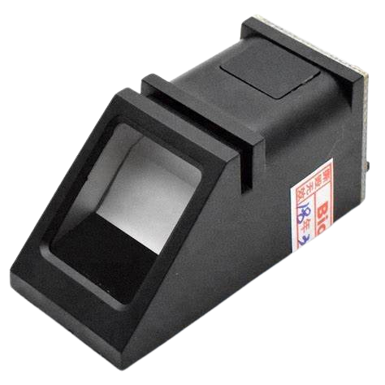
Finger print module:
1. Working Principle:
- Utilizes capacitive/optical technology, Converts data into a digital template for comparison.
2. Key Features:
- High-resolution for accurate fingerprint representation.
- Connects seamlessly with Raspberry Pi through digital pins.
3. Security Measures:
- Advanced algorithms for secure data storage.
- Safeguards against unauthorized access.
4. Real-time Authentication:
- Enables quick and real-time voter authentication, integrity .

Slide 7
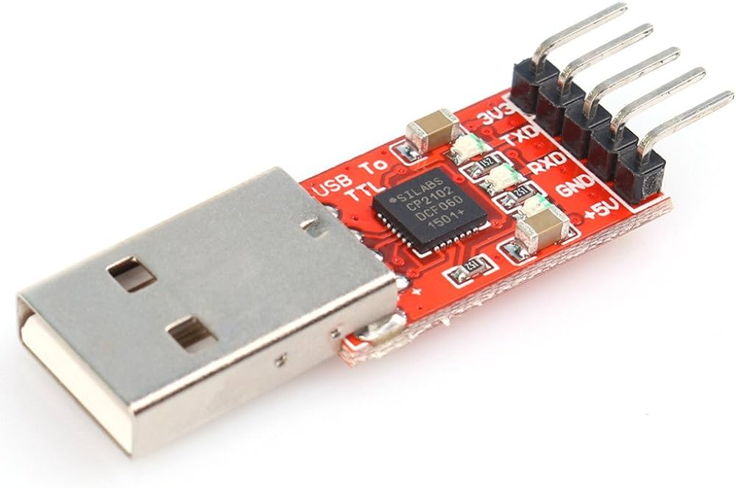
USB to TTL module:
TXD (Transmit Data): Transmits data from the Raspberry Pi to the fingerprint sensor.
RXD (Receive Data): Receives data from the fingerprint sensor to the Raspberry Pi.
GND (Ground): Common ground for all devices.
VCC: Provides power to the converter.
High-Speed Communication:
- Supports baud rates up to 1 Mbps for fast data transmission.
Low Latency:
- Minimal delay in data transmission

Slide 8
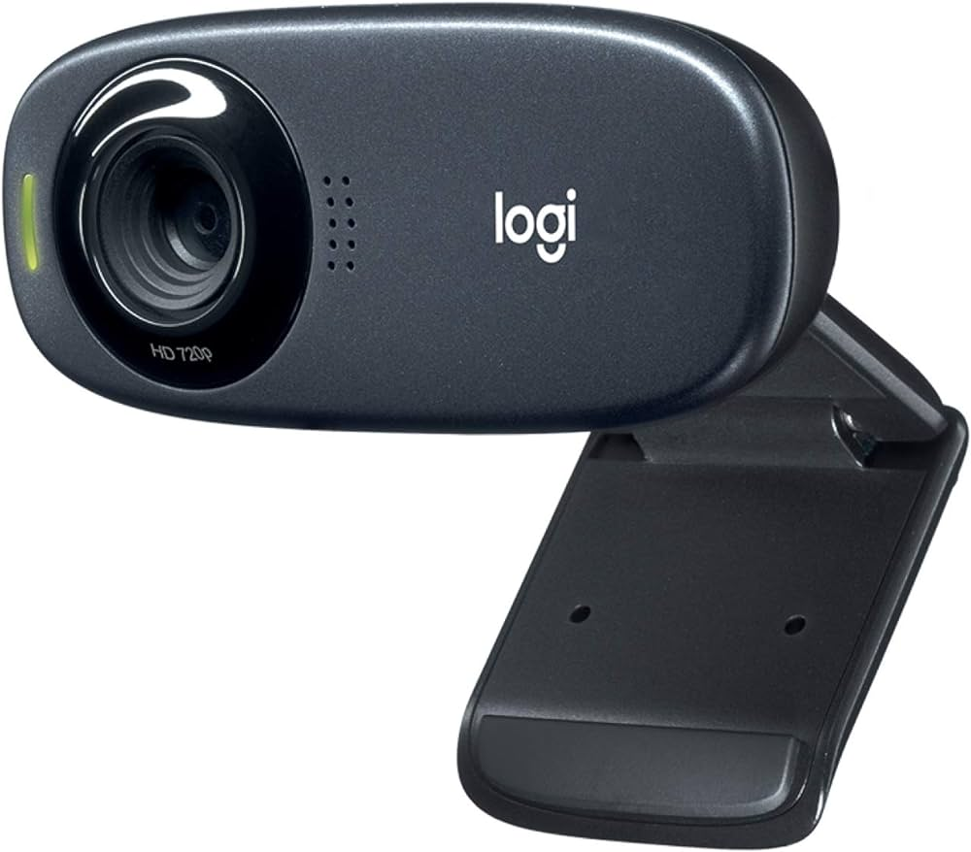
USB Cam Module:
1. Capture Function:
- Essential for facial data in biometric authentication.
2. Technical Specifications:
- High resolution for clear facial images.
- Support Real-time frame rate identification.
3. Integration:
- Seamlessly interfaces Raspberry Pi.
- Supports efficient data transfer for facial recognition.
4. Security:
- Implements encryption for secure storage and transmission.
- Controls access to authorized personnel.

Slide 9
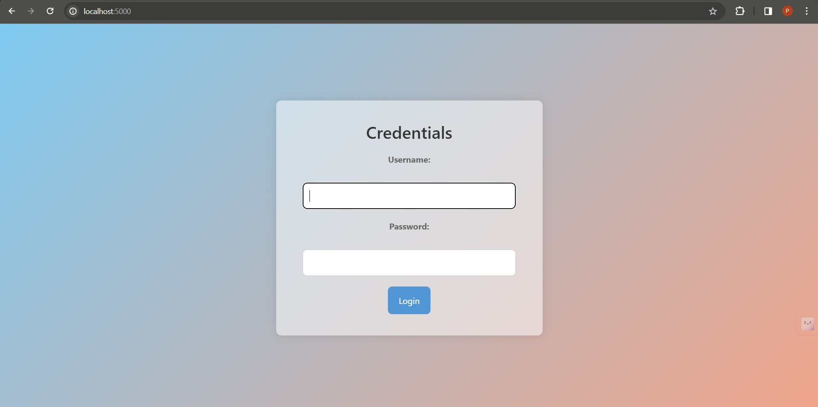
Webpage:

Slide 10
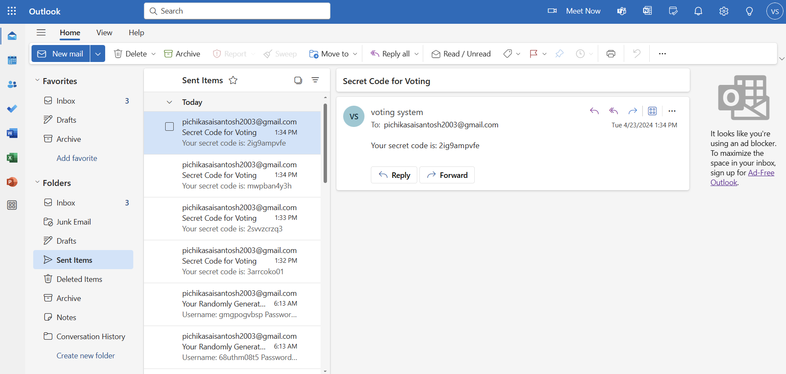
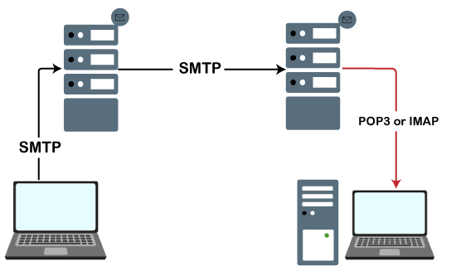
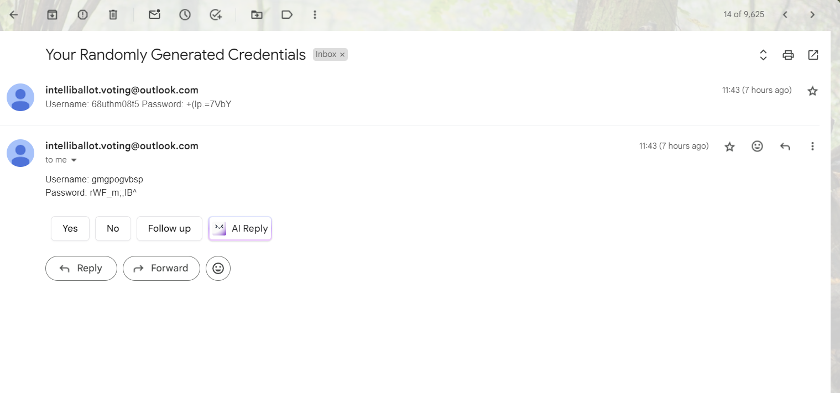
Increased in Security:
Mail Server
Providing real-time processing of credentials
Sender
SMTPLIB
Receiver

Slide 11



Comparison:
Normal Electronic Voting System
Electronic Voting System with Fingerprint and Face Recognition
Relies on manual entry of voter ID or other identification.
Vulnerable to identity fraud.
Prone to human error in verification.
Authentication process may take longer.
Generally fewer privacy concerns.
Uses biometric data (fingerprint or face) for authentication.
Enhances security by biometrically verifying the voter's identity.
Provides more accurate verification with biometric data.
Automates authentication, potentially reducing waiting times at polling stations.
Raises privacy concerns due to the collection and storage of biometric data.

Slide 12
Advantages:
IntelliBallot
Enhanced Security
Reduced Fraud
Accurate Voter Identification
Versatility in Authentication
Real-time Authentication
Data Encryption and Access Control

Slide 13
Future Scope:
1. Integration with Aadhar Database: Directly accessing verified voter information from the Aadhar database streamlines authentication, reducing fraud risk.
2. Multi-factor Authentication: Combining biometric verification with additional authentication layers enhances system security against unauthorized access.
3. End-to-End Encryption: Ensuring data confidentiality through encryption safeguards voter information from interception or tampering.
4. Continuous Monitoring and Auditing: Real-time surveillance enables prompt detection and response to suspicious activities, maintaining electoral integrity.
5. Redundancy and Failover Mechanisms: Backup systems ensure uninterrupted access to voting services, mitigating disruptions or hardware failures.
6. Collaboration with Cybersecurity Experts: Partnering with experts ensures ongoing assessment and improvement of system security, bolstering trust and reliability.

Slide 14

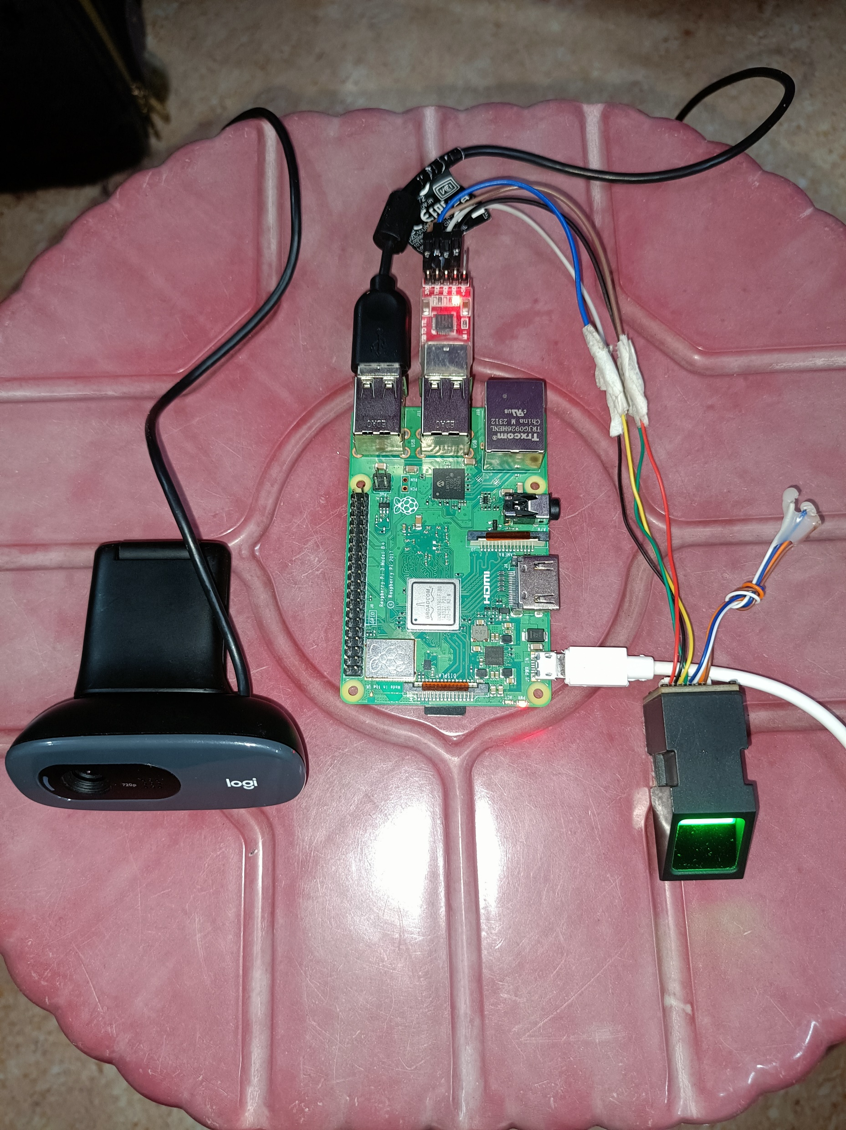
Output:

Slide 15
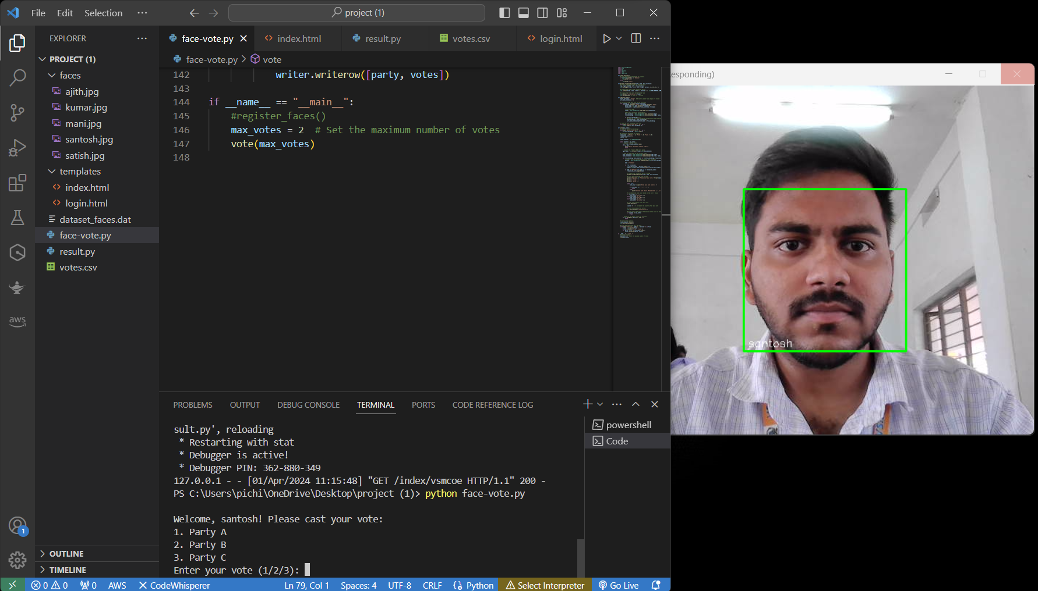
Output:

Slide 16
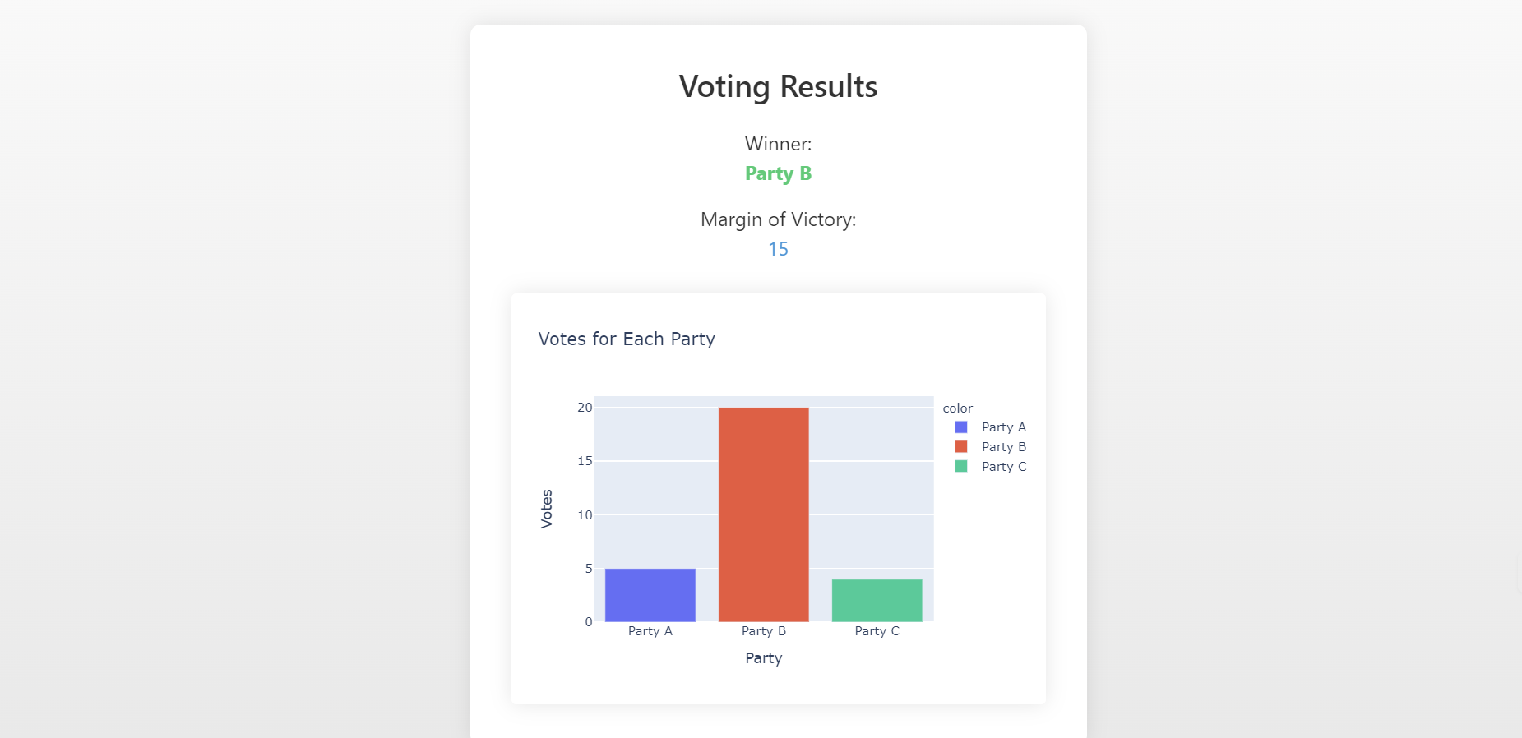
Output:
Output Video

Slide 17
References:
[1] Bhuiyan, M.S., Rehman, M.M., and Hossain, M.R. “Electronic Voting System”, B.Sc. Thesis, Department of Computer Science & Engineering, , BRAC University, Dhaka, Bangladesh, January, 2007.
[2] Traoré, J., “An Introduction to Electronic Voting Application to Single Transferable Vote”, Orange Labs, July, 2014.
[3] Whither Biometrics Committee, “Biometric Recognition: Challenges and Opportunities”, National Academies Press, 2010.
[4] Drexler, J., and Dyball, C.J., “Anti-Fraud Voter Registration and Voting System using a Data Card”, Google Patents, 1995.
[5] Sehr, R.P., “Computerized Voting Information System Having Predefined Content and Voting Templates”, google patents, 1999

Slide 18
ANY QUERIES?

Slide 19
THANK YOU

